Slide 1

Commercial
Flight Analysis
Aisyah Amatul Ghina | Manuel Ramos | Marco Moras | Maurits Siemonsma

Slide 2
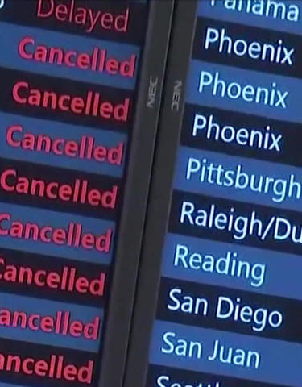

Project Overview
Project objective: researching airlines based on records for flight delays and flight cancellations, and provide insights for frequent travelers or business travelers for their next flights.
Which are the most reliable airlines?
Which airlines have the most delays?
Which airlines have the most cancellations?

Slide 3

Data Acquisition
Challenges
Primary Dataset
Data alignment between databases
Data cleaning and wrangling for analysis
Management of big dataset and importing into MySQL Workbench (file size)
U.S. Commercial Flight Delays
Kaggle
Complementary Dataset
Airlines code - Openflights
City Code - U.S. Dept of Transportation
Notes:
Highlight the primary sources of data and any complementary datasets.
Discuss challenges faced during the data sourcing and integration.
Briefly describe how the supplemental data aligns with your primary dataset.

Slide 4
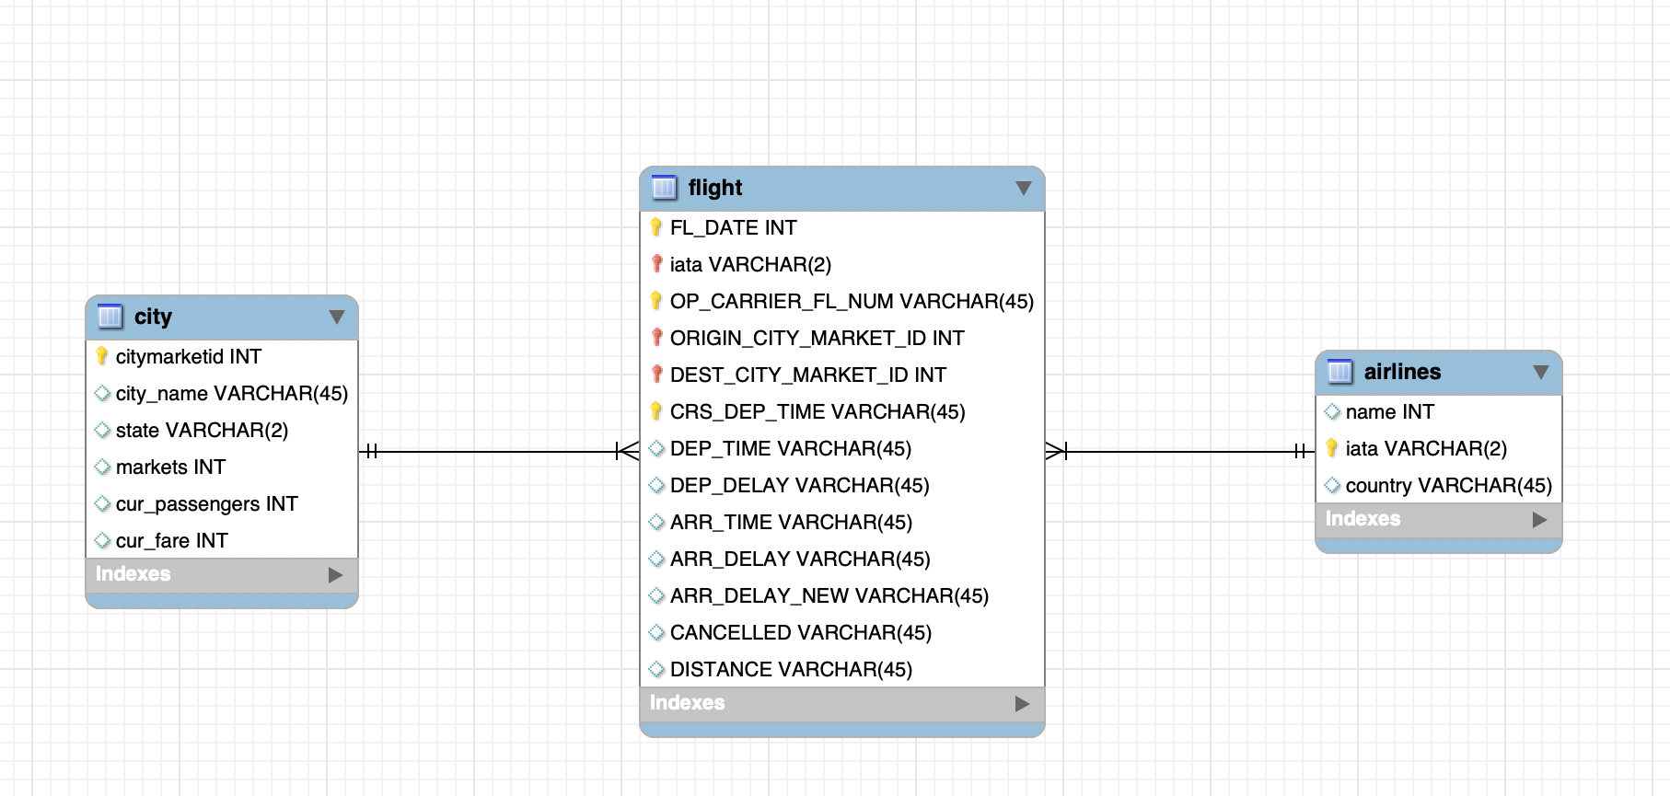
Database Design

Slide 5
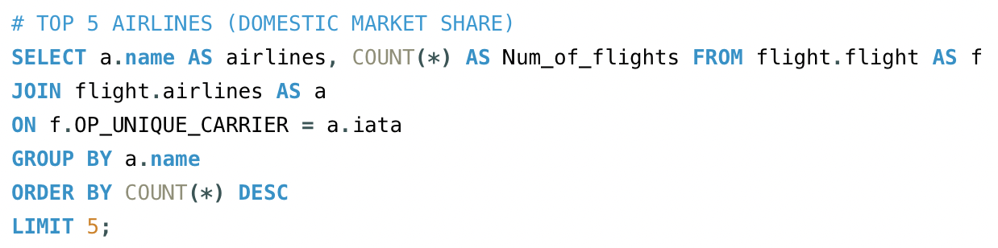
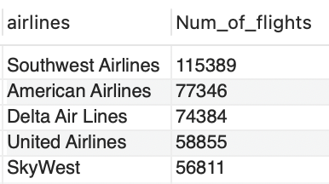
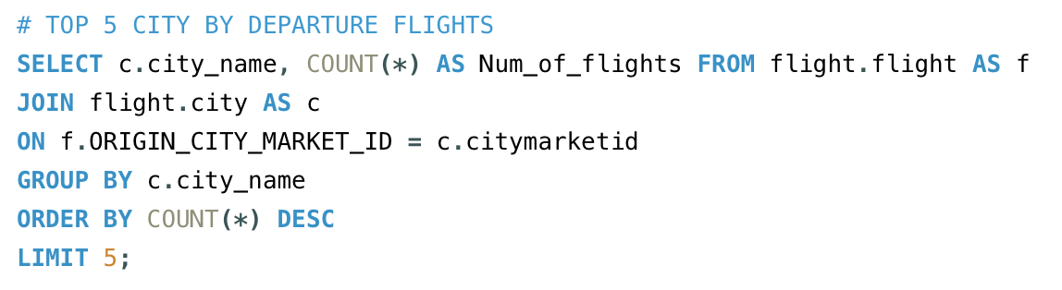
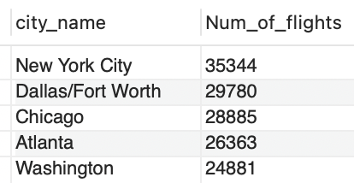
SQL Insights

Slide 6
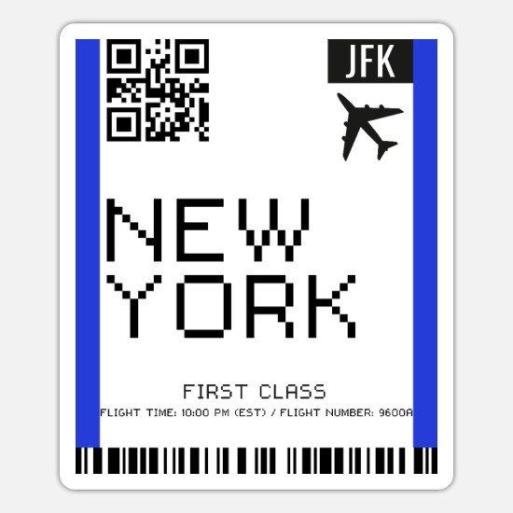
SQL Insights
Insights and highlights:
Management of large databases: import of heavy files into MySQL Workbench
Data granularity: lengthy process of data point selection and data cleaning
Data set alignment: datasets from different sources require extra checks.

Slide 7
Visualization & Key Insights

Slide 8
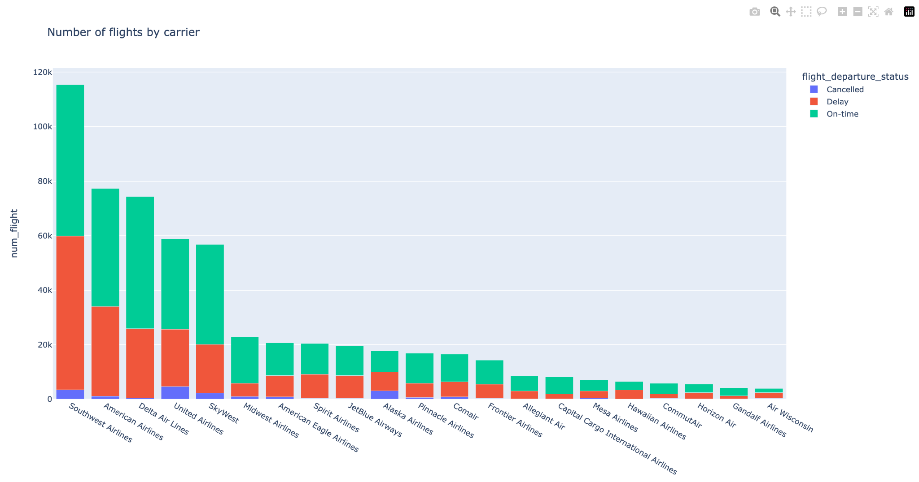





U.S. Commercial Domestic Flights January 2024
Top 5 Leading Airlines
with 56% of domestic market share

Slide 9
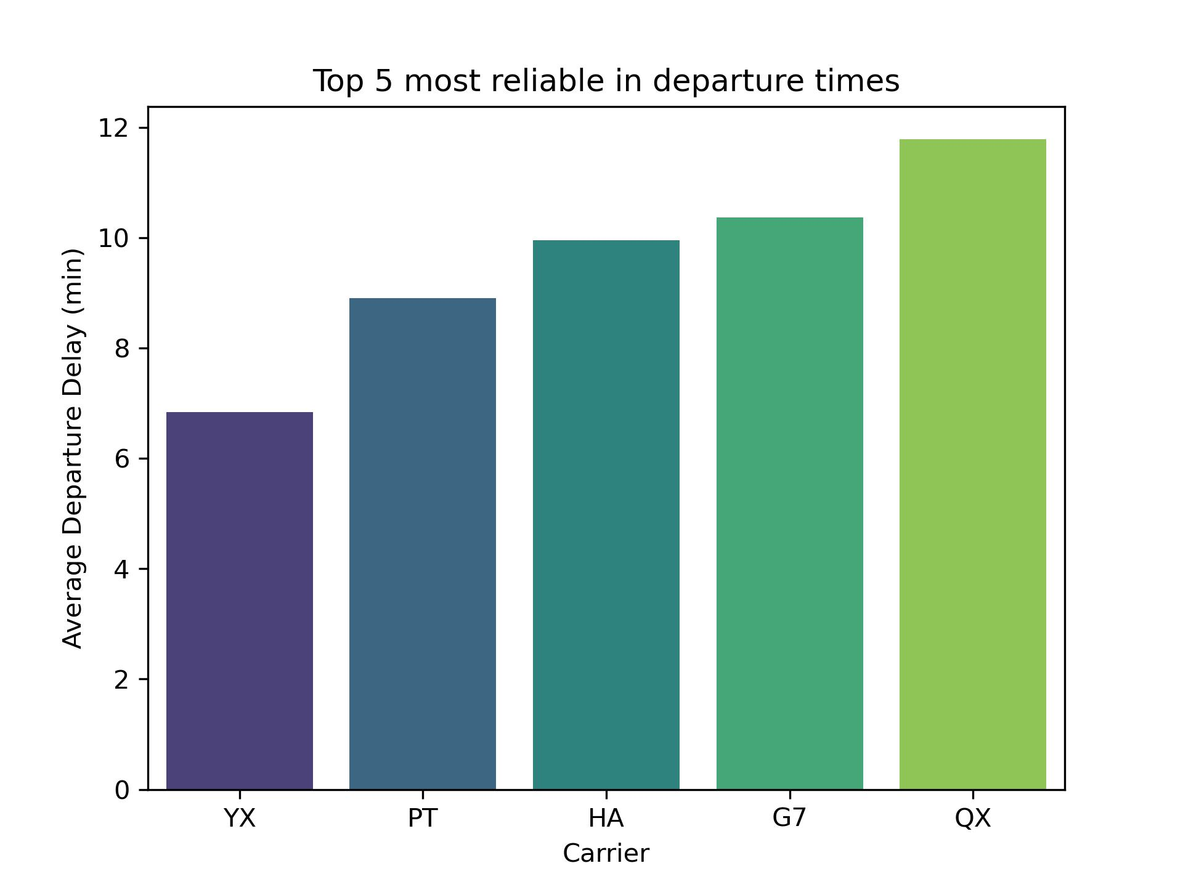
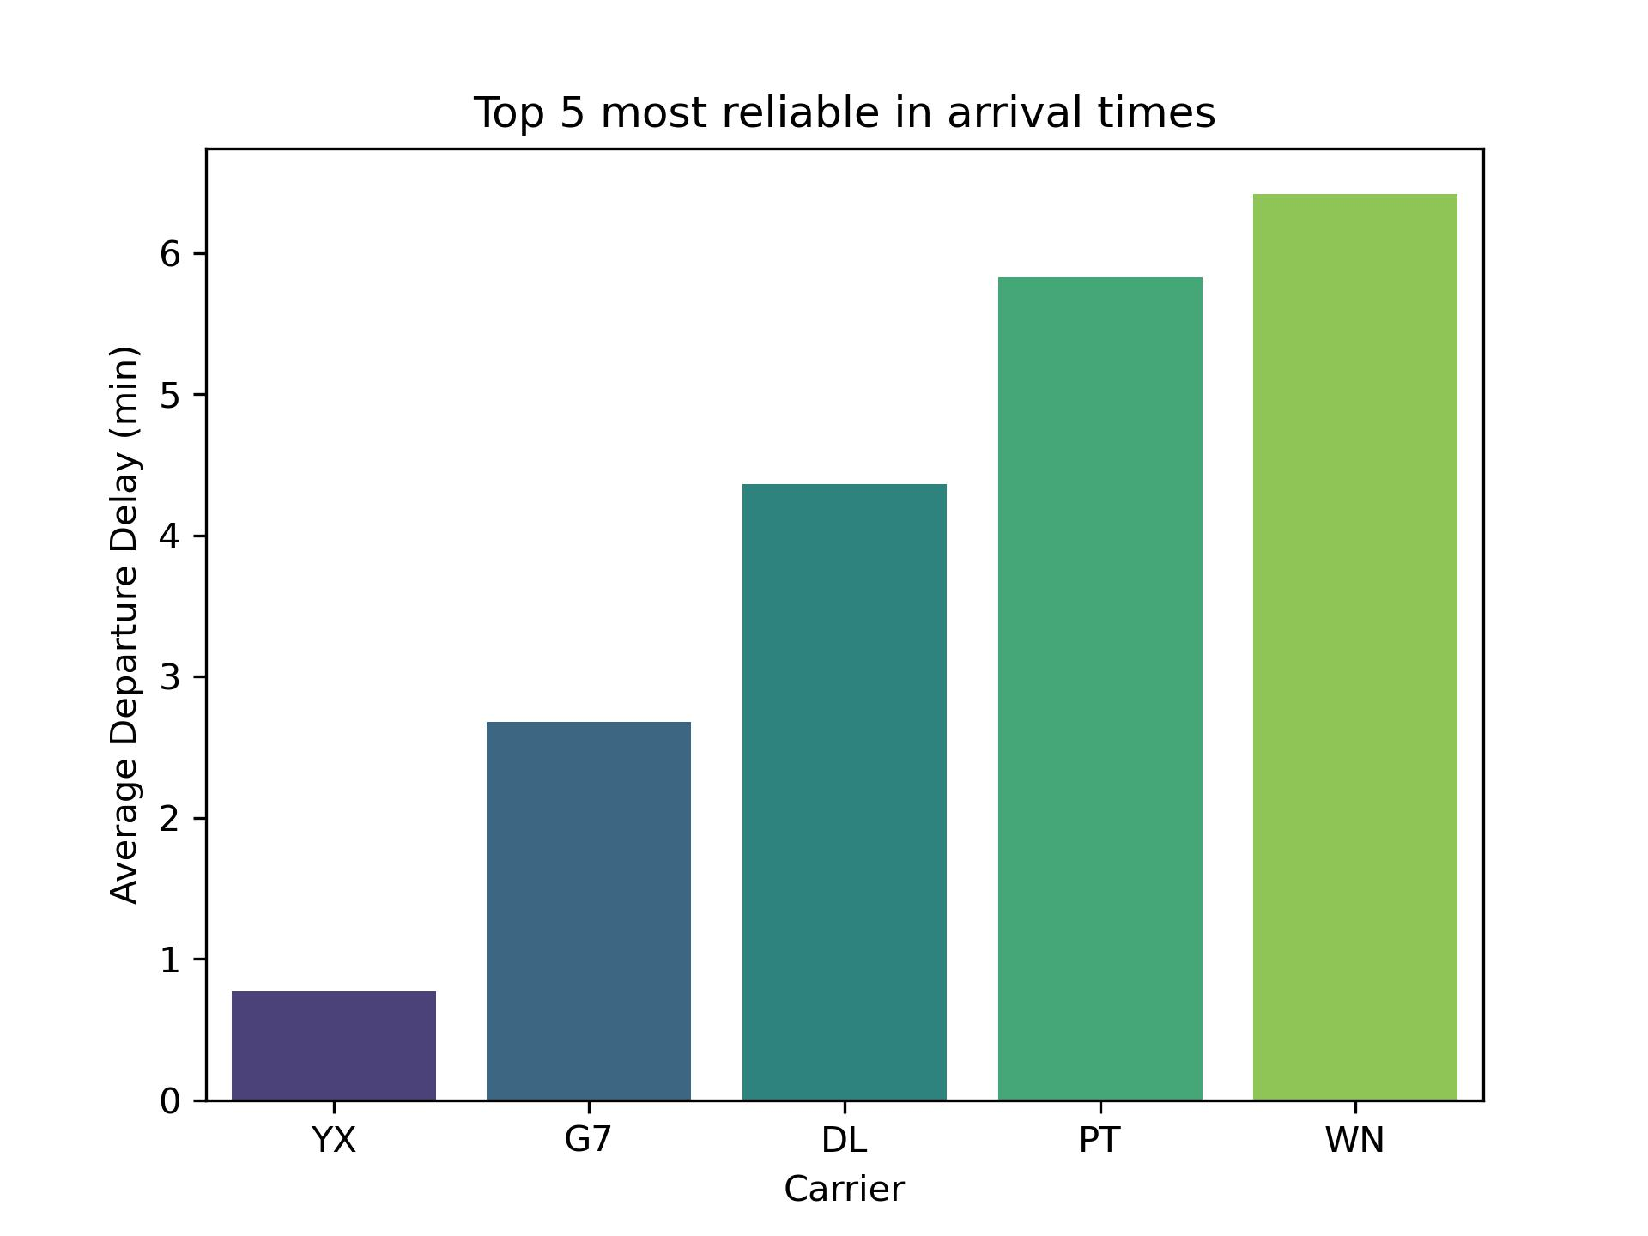
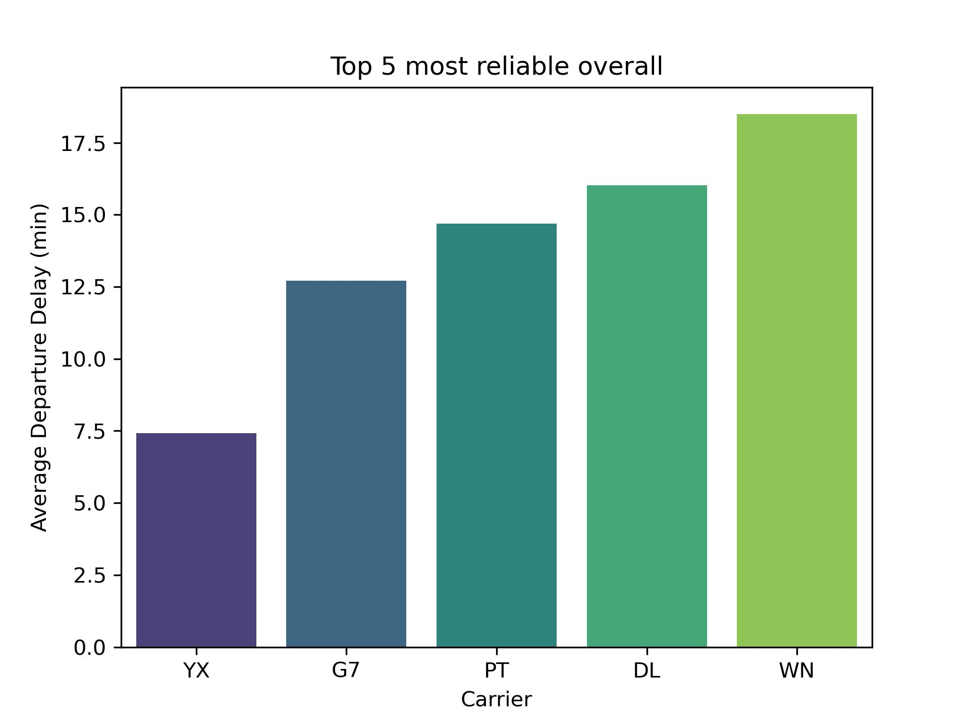
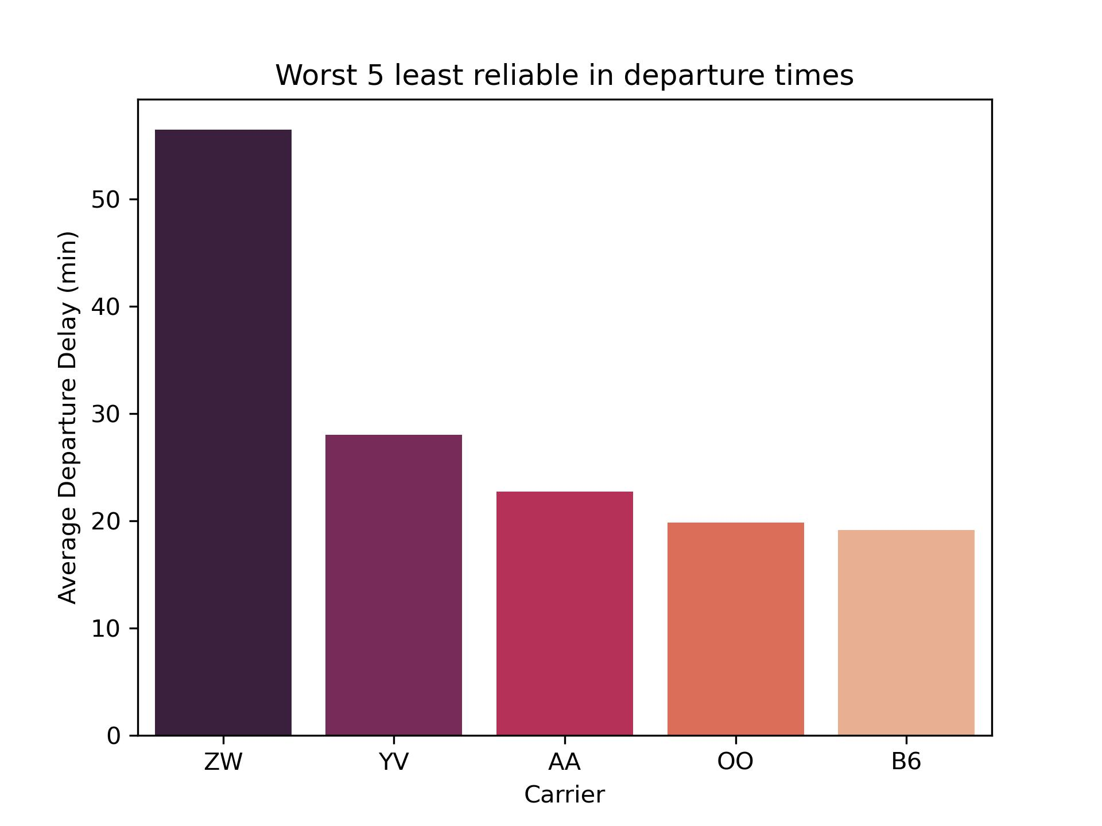
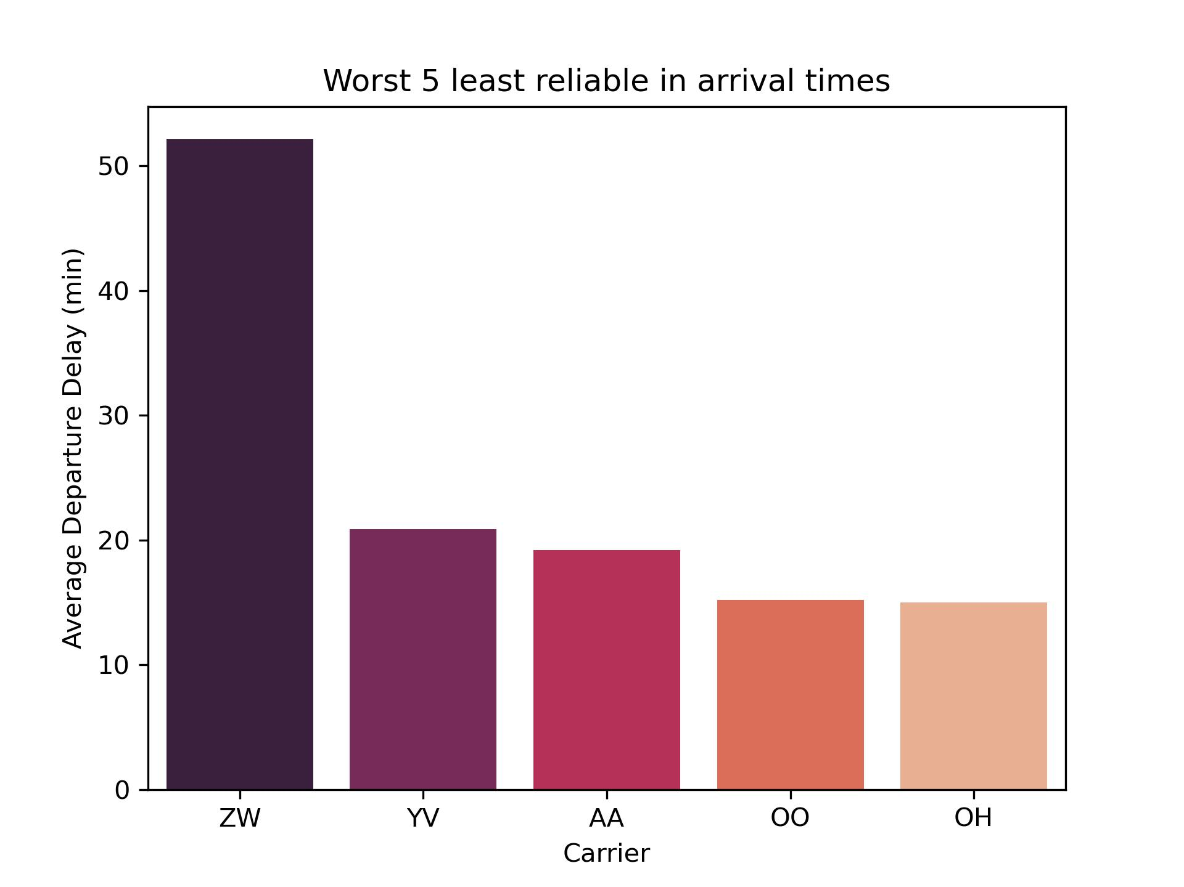
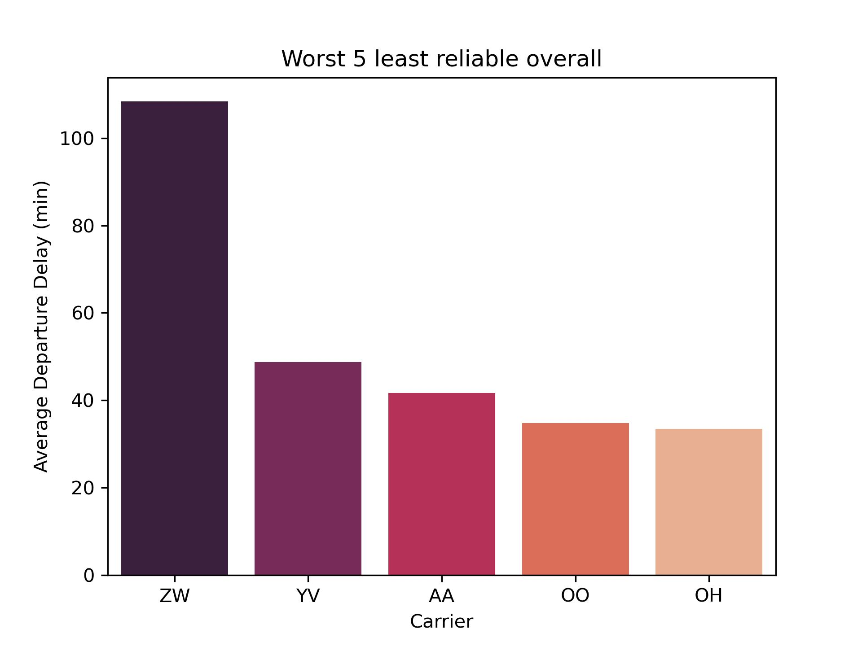
Reliability / On-time Performance
TOP 5 PERFORMERS [:5]
Mid-West Airlines (YX) and Gold Jet Airlines (G7) airlines are top choices in terms of on-time reliability
WORST 5 PERFORMERS [-5:]
“Air Wisconsin” (ZW) and “Mesa Airlines” (YV) airlines are the worst performers in terms of on-time reliability
Notes:
Show some of the primary visualizations developed.
Discuss the major insights derived from the visualizations.

Slide 10
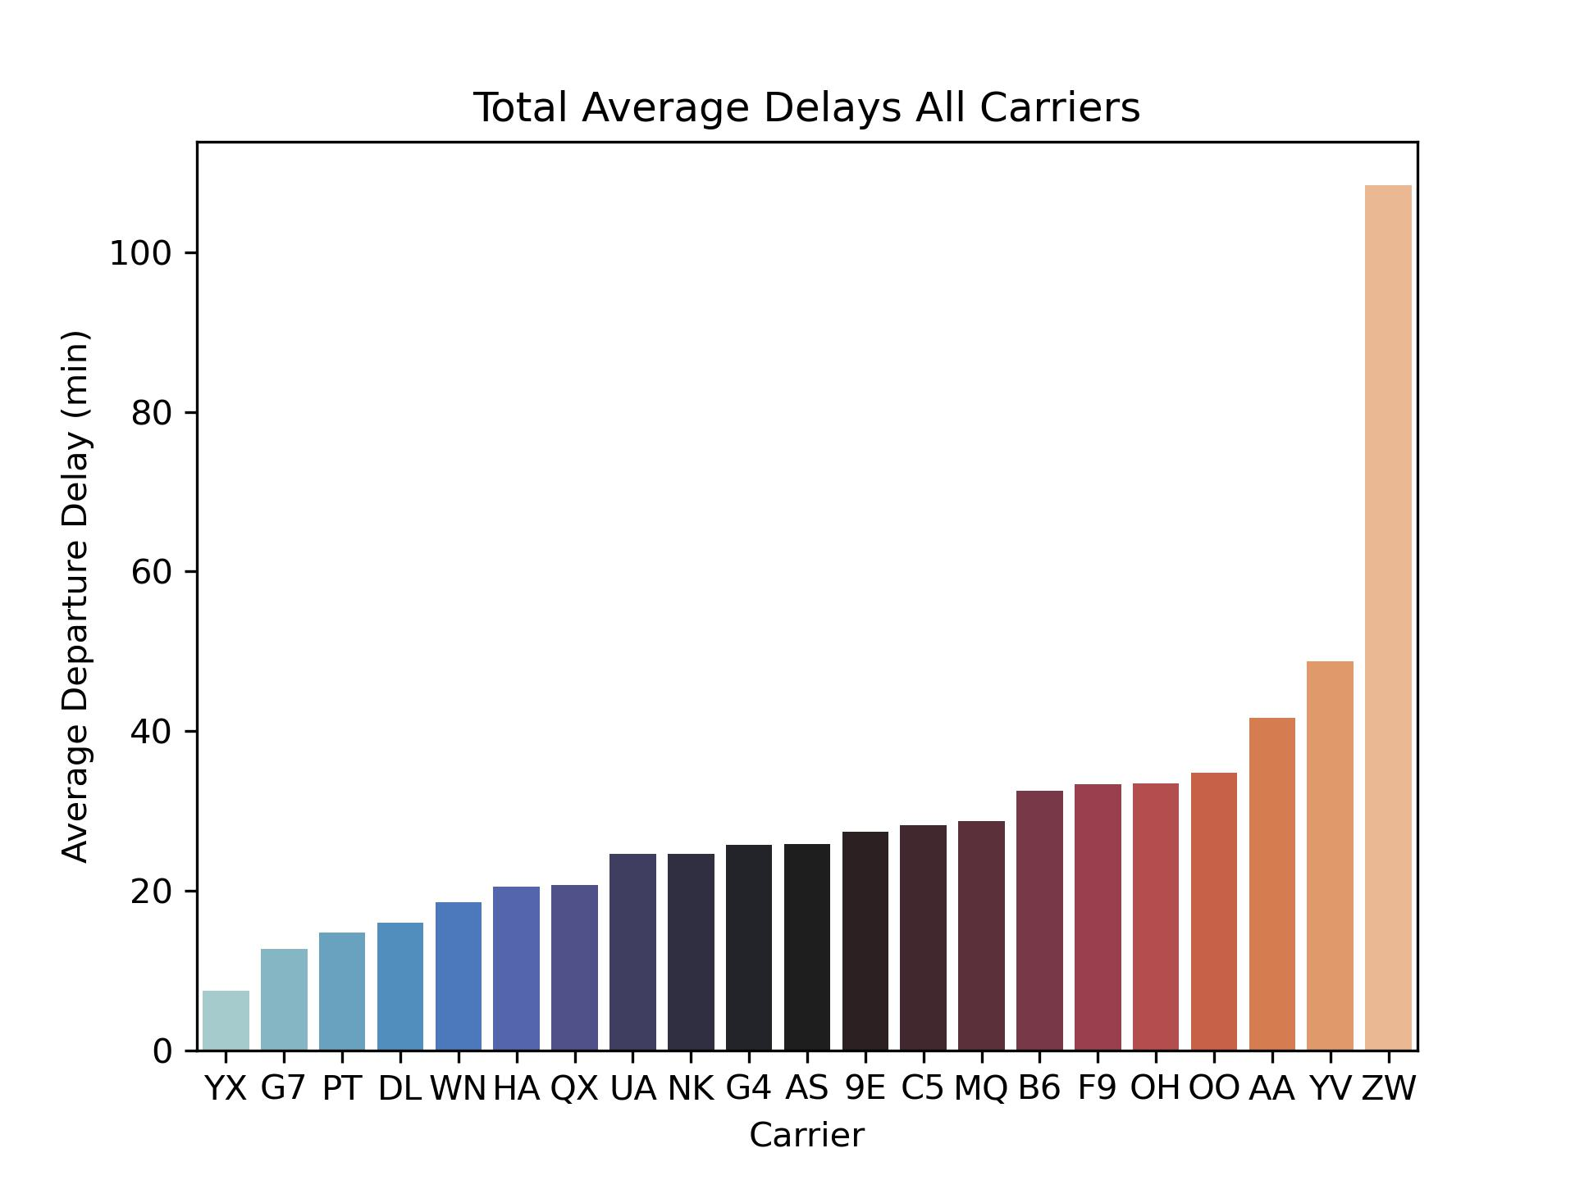
Reliability / On-time Performance (continued)
Statistics of average delays [:]
Mean: 30 minutes
Minimum: 7 minutes
Maximum: 109 minutes
Median: 26 minutes

Slide 11
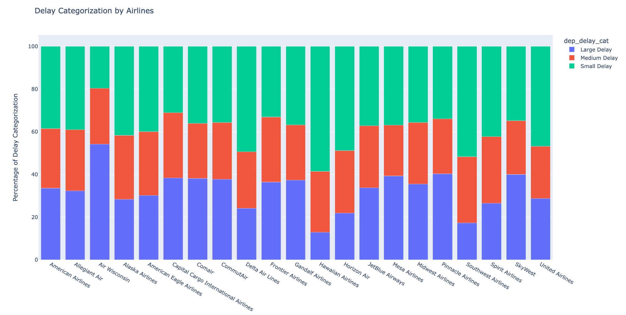
Delayed Analysis
Average of Small Delay
Notes:
Delays are divided into three categories, namely:
# 1. "Small delay" (up to 15 minutes delay)
# 2. "Medium delay" (15 – 45 minutes delay)
# 3. "Large delay" (>45 minutes delay)

Slide 12
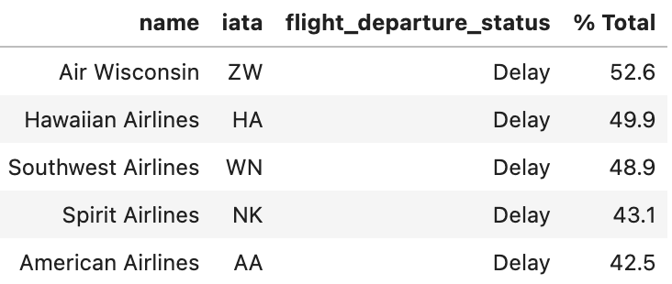
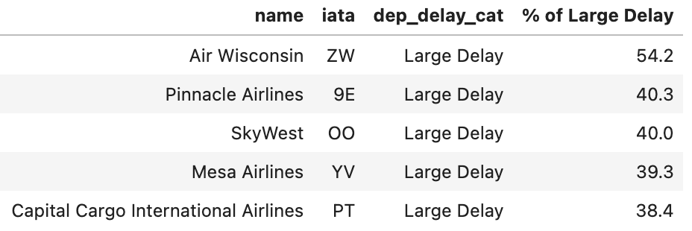
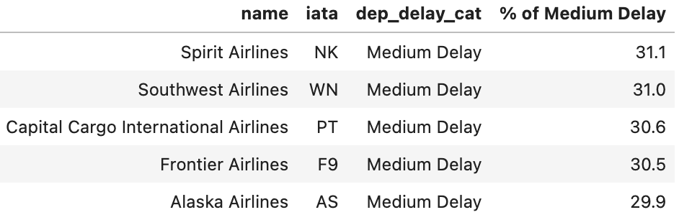
Delayed Analysis
Worst Airlines - % Delays out of Total Flights
Worst Airlines - Large Delays (>45 mins)
Worst Airlines - Medium Delays (15-45 mins)
More than half of Air Wisconsin flights were delayed and most of it were large delays.
One of the leading airlines, SkyWest, is among the worst airlines with large delays.

Slide 13
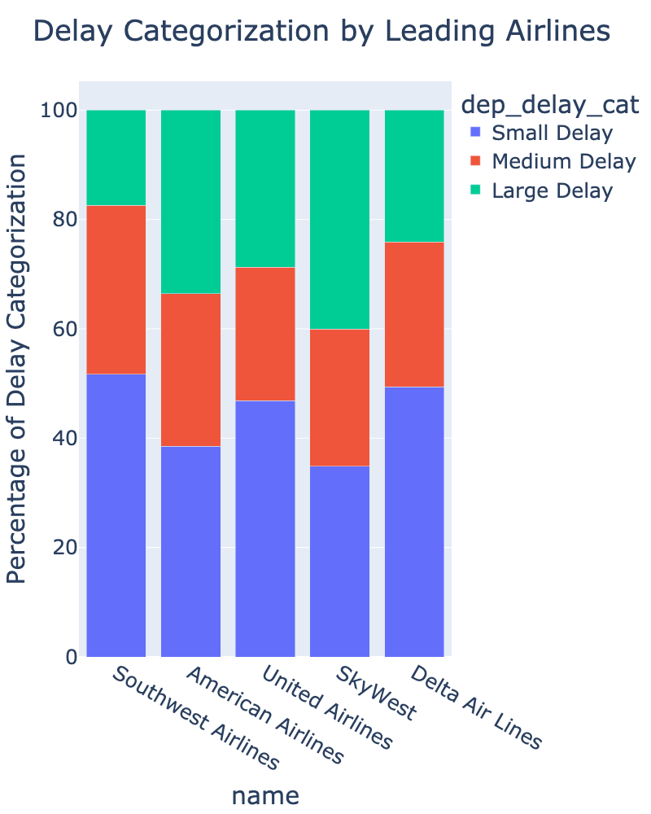
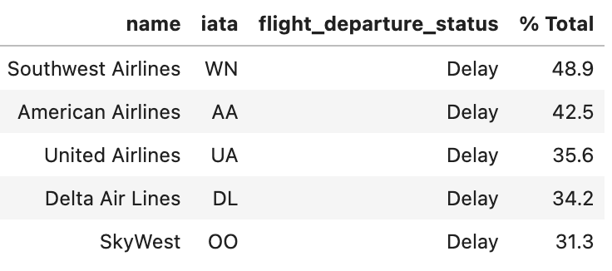
Delayed Analysis of Leading Airlines
% Delayed out of Total Flights
Among the leading airlines, Southwest Airlines and American Airlines have the most delayed flights.
Most (51%) of Southwest Airlines delays were small delays.
Although SkyWest has the lowest percentage of delayed flights, most of the delays (40%) were large delays.
Notes:
Among the top 5 leading airlines, Southwest Airlines and Delta Airlines have less risk in terms of delay.

Slide 14
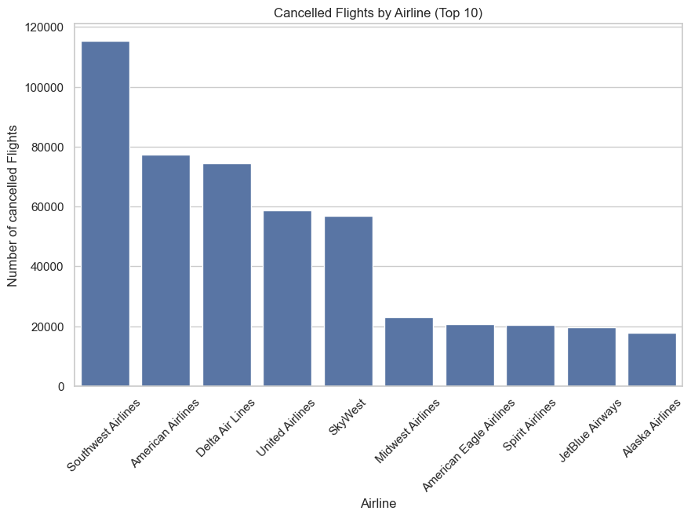
Cancelled Flights
Airlines with the highest number of cancelled flights:
Southwest Airlines (115,389)
American Airlines (77,346)
Delta Air Lines (74,384)

Slide 15
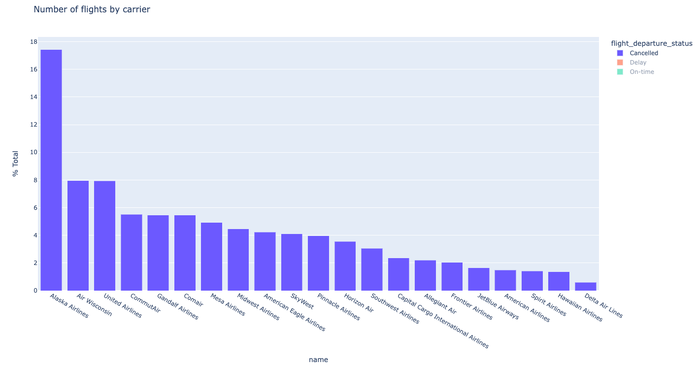
Cancelled Flights
Airlines with the highest % of cancelled flights:
Alaska Airlines (17%)
Air Wisconsin (8%)
United Airlines (8%)

Slide 16
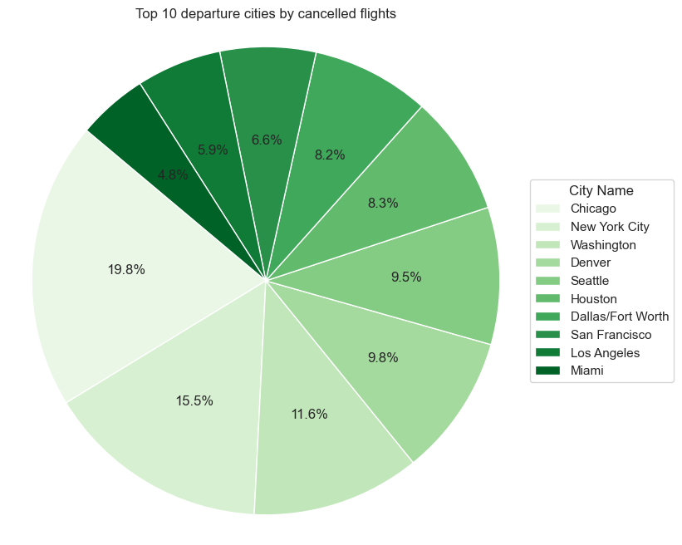
Cancelled Flights
Cities with the highest number of cancelled departing flights:
Chicago (2,140)
NYC (1,670)
Washington (1,255)

Slide 17
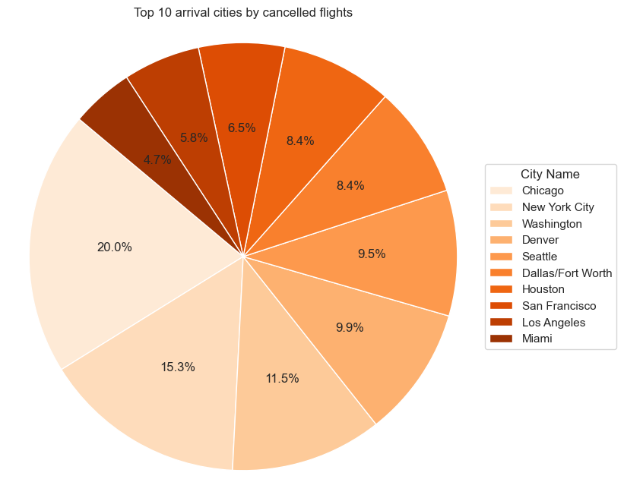
Cancelled Flights
Cities with the highest number of cancelled arriving flights:
Chicago (2,216)
NYC (1,703)
Washington (1,271)

Slide 18
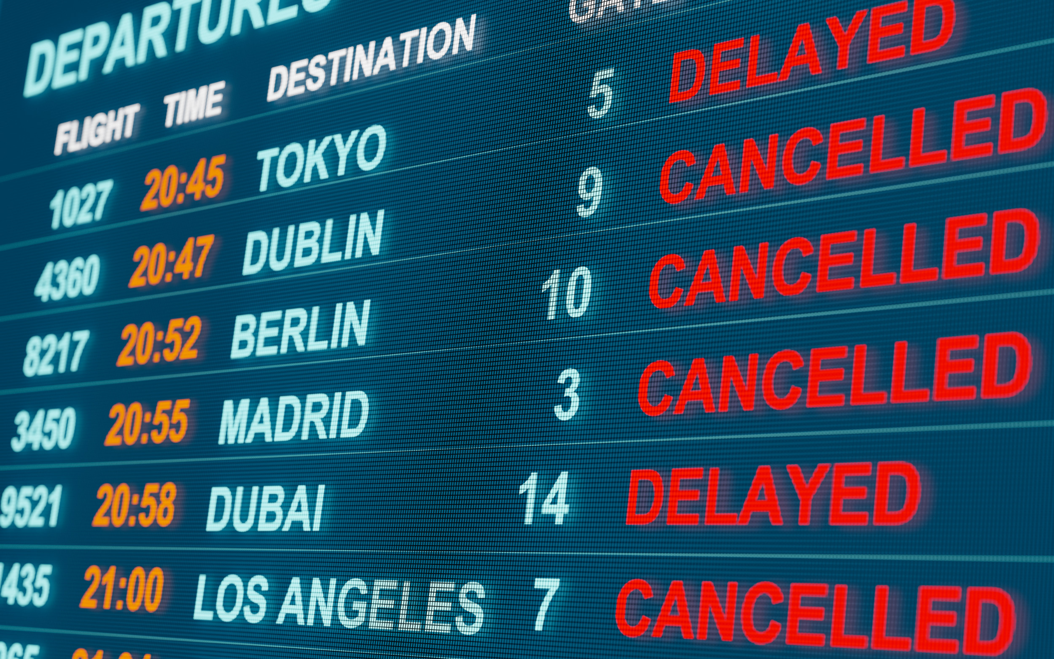
Conclusions & Business Implications
Among the top 5 leading airlines, Southwest Airlines and Delta Airlines have less risk in terms of delay flights.
Among the leading airlines, Southwest Airlines and American Airlines have the most delayed flights.
Southwest Airlines and American Airlines also have the most cancellations.
It is expected to see the same airlines at the top of the lists in all analyses since they have such a large share of the total market.
👍🏻Our advice is to fly with Mid-West Airlines or Gold Jet Airlines if you want to fly on time.

Slide 19
Major Obstacle
Lessons Learned
Obstacle 1: loading large csv data into MySQL
Obstacle 2: incorrect information in databases
Obstacle 3: data cleaning
There may be alternative ways to working with large data files
Double or triple check the information source for the databases
Several steps needed for data normalization and this could have been implemented further

Slide 20

Suggestions for further insights
Improve advice to include flight price considerations;
Analyse if on-time performance correlates to flight prices (we did not find price data ourselves);
Analyse what the actual reason is for flight delays (e.g. geographical location, infrastructural challenges, local demand);
Factor in seasonal demand (e.g. holidays may translate into more delays and higher prices).

Slide 21

THANKS!
Aisyah Amatul Ghina
Manuel Ramos
Marco Moras
Maurits Siemonsma

